Slide 1
OSI (Open Systems interconnection) Model

Slide 2
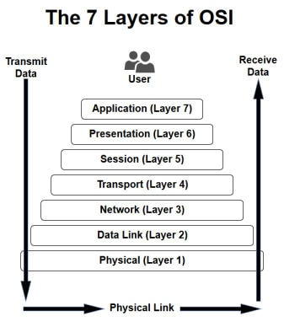
This are the layers of OSI Model
Send sends data in “top-down ” approach
Receiver receives data in “bottom-up approach”
1st four layers are known as software layer or upper layer where last three layers are known as hardware layer or lower layer
Transport layer is also known as heart of OSI Model

Slide 3
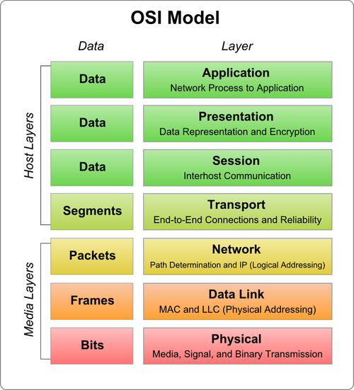
This image shows 1st three layer working on Data
4th layer working on Segments
5th layer working on Packets
6th layer working on Frames and at the end 7th layer working on Bits
Data = Packet = segments = frames only name differs according to layers

Slide 4
Layers With its functions
Application Layer:
Which is known as Host Layer also and it is used Data as a Protocol Data Unit (PDU).
Main Tasks:
High level APIs
Remote file access
Internet usage
Resource sharing
Protocols:
HTTP, FTP, HTTPS, SMTP, SSH, Telnet (same as in Presentation Layer and Session Layer)

Slide 5
Presentation Layer:
Which is known as Host Layer also and it is used Data as PDU.
Translation of data between a networking service and an application.
Main Tasks:
Translation
Character encoding
Data Compression (5 MB file to 2 MB file)
Conversion (JPEG to PNG, Word to PDF)
Encryption / Decryption

Slide 6
Session Layer:
Which is known as Host Layer also and it is used Data as PDU.
Managing Communication sessions, i.e. continuous exchange of information in the form of multiple back-and-forth transmission between nodes.
Ex. Online Transaction Websites
Main Tasks:
Managing
Authentication (Enter login ID and Password)
Authorization (Successfully login to the account)

Slide 7
Transport Layer:
Which is known as Host Layer also and it is used Segment or Datagram as PDU
Reliable data transmission of data segments between points on a network.
Protocols:
TCP(Transmission Control Protocol),
UDP (User Datagram Protocol)
Main Tasks:
Segmentation
Acknowledgement
Multiplexing
End to end Delivery

Slide 8
Network Layer:
Which is known as Media Layer also and it is used Packet as PDU.
Structuring and managing a multi-node network.
Protocols:
BGP
IP
RIP
OSPF
EIGRP
DHCP
ICMP
Main Tasks:
Addressing
Routing
Traffic (Congestion Control)
Logical Addressing

Slide 9
Data Link Layer:
Which is known as Media Layer also and It is used Frames as PDU.
Reliable transmission of data frames between two nodes connected by a physical layer
Protocols:
Ethernet
FR (Frame Relay)
MAC
Main Tasks:
Physical Addressing

Slide 10
Physical Layer:
Which is known as Media Layer also and It is used Bits as a PDU.
Transmission and reception of raw bit streams over a physical medium.
It uses Co-axial cable, Fiber cable, RJ-45 etc.
Main Tasks:
Media
Signal
Binary Transmission

